Slide 1
PERIPHERAL ARTERY DISEASE
DR.SURESH S
SR CARDIOLOGY
CALICUT MEDICAL COLLEGE

Slide 2
PAD
PAD –acute or chronic obstruction of the arteries supplying the lower or upper extremities, when severe causes downstream ischemia and tissue loss

Slide 3
Peripheral artery diseases (PAD)
Peripheral artery disease (PAD) generally refers to a disorder that obstructs the blood supply to the lower or upper extremities
90-95 % atherosclerosis
5-10% thrombosis, embolism, vasculitis, fibromuscular dysplasia, entrapment
Impact on quality of life + mortality (cardiovascular)
> 50% patients with PAD at the same time suffer from coronary atherosclerosis, 15-40% from carotid atherosclerosis

Slide 4
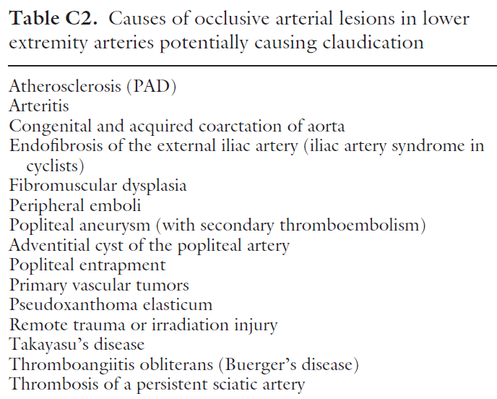

Slide 5
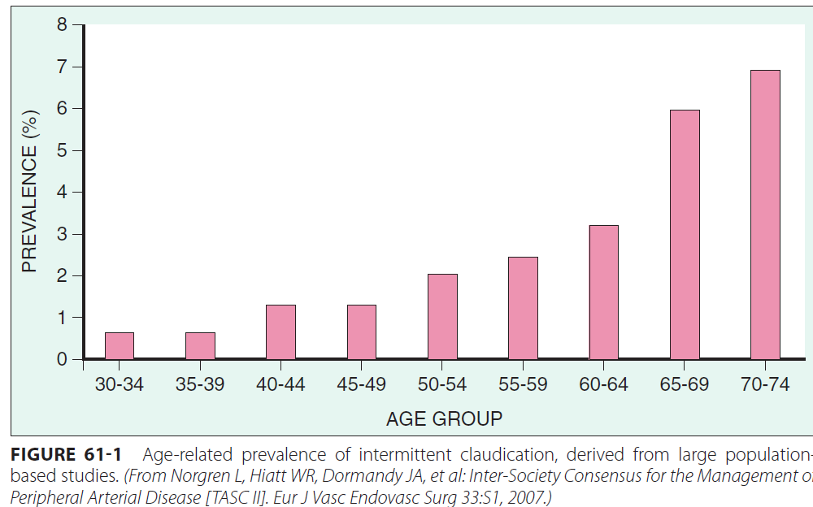
EPIDEMIOLOGY

Slide 6
Overlap of Atherosclerotic Disease
38% overlap
> 2 Vascular beds
Patients with one manifestation often have coexisted disease in other vascular beds

Slide 7
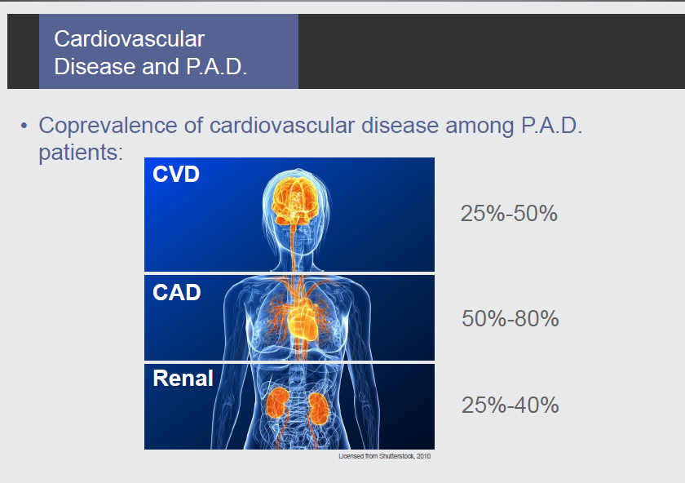

Slide 8
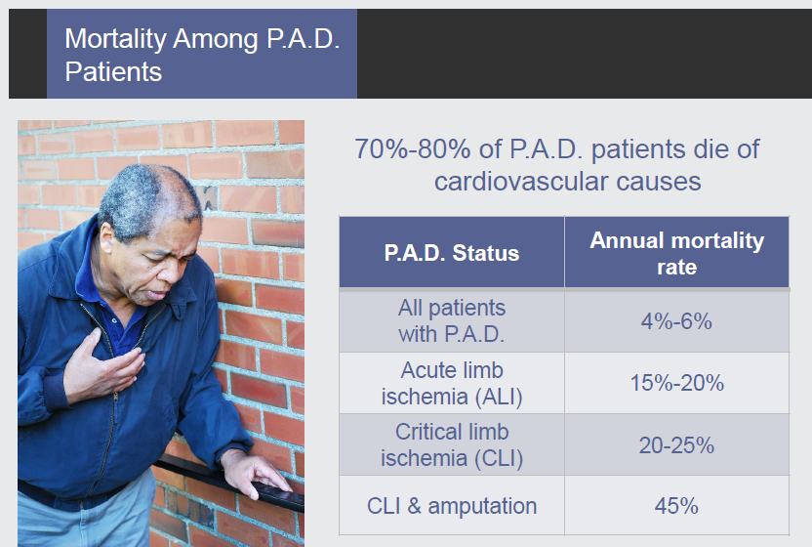

Slide 9
Symptomatic + Asymptomatic PAD

Slide 10
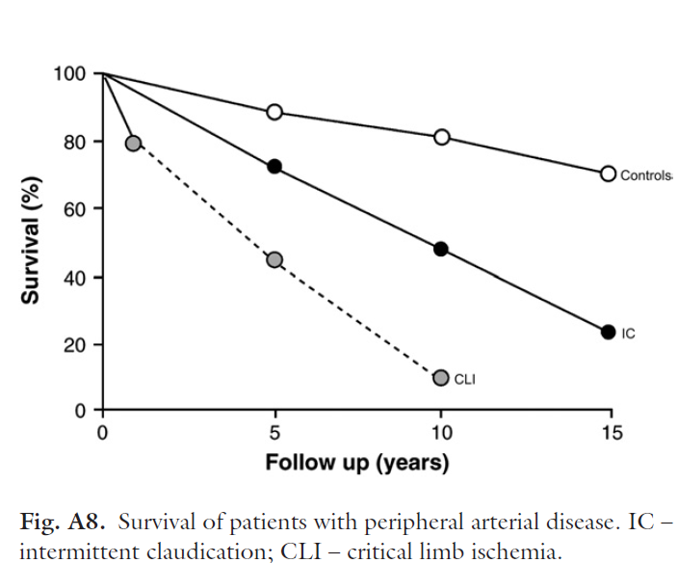

Slide 11
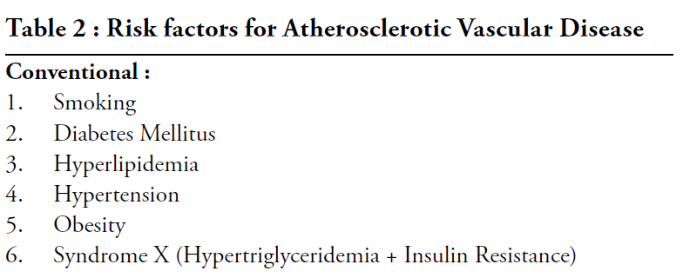

Slide 12
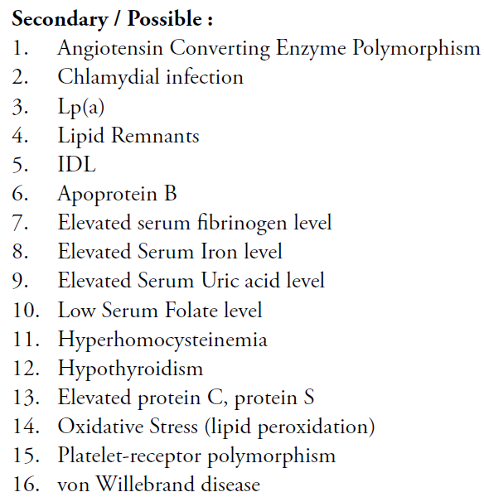

Slide 13
Risk Factors for PAD
Reduced
Increased
Smoking
Diabetes
Hypertension
Hypercholesterolemia
Hyperhomocysteinemia
Fibrinogen
C-Reactive Protein
Alcohol
Relative Risk
.5 1 2 3 4 5 6
Notes:
Risk Factors for PAD
The graph shows relative risk of developing PAD associated with 8
factors.
Smoking is the factor that most elevates the risk for PAD; it has been
recognized for more than 90 years that intermittent claudication was 3
times more prevalent in smokers than nonsmokers. Framingham data
indicate that the risk of PAD from smoking is almost double that for
CAD. A diagnosis of PAD is made up to 10 years earlier in smokers
compared with nonsmokers.⁴
Diabetes significantly (P<.001) increases the risk of PAD. The relative
risk was found to be increased by a ratio of 4.05 (95% CI, 2.8-5.9) in
the Cardiovascular Health Study, which evaluated almost 5100
persons age 65 or older.¹ Other studies have found intermittent
claudication to be twice as common in diabetics as in nondiabetics.⁴
Hypertension (HTN) increases the risk of PAD by a factor of 2.5 in men
and 3.9 in women, according to Framingham data. Some studies,
however, have found no association. It has been suggested that HTN
may delay the onset of symptoms of intermittent claudication by
elevating central perfusion pressure. Sometimes hypertensive patients
develop intermittent claudication when HTN is discovered and treated.⁴
(notes continue →)

Slide 14
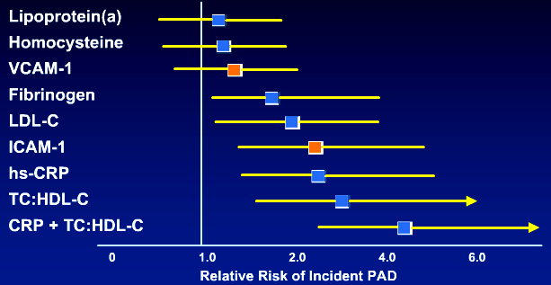
Nobel Risk Factors as Predictors of PAD
Adjusted for age, smokin, DM, family history, HTN, exercise level, and BMI

Slide 15
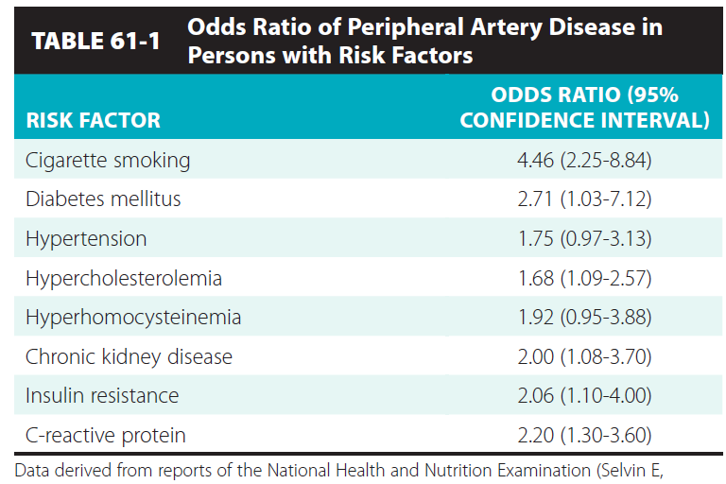

Slide 16
Atherosclerosis:
A Progressive and Systemic Process
Plaque
Rupture/
Fissure &
Thrombosis
Occlusive
Atherosclerotic
Plaque
Unstable
Angina
Fatty
Streak
Fibrous
Plaque
Normal
MI
Coronary
Death
Stroke
Effort Angina
Claudication
Renovascular Dz
Clinically Silent
Critical Leg Ischemia
Increasing Age

Slide 17
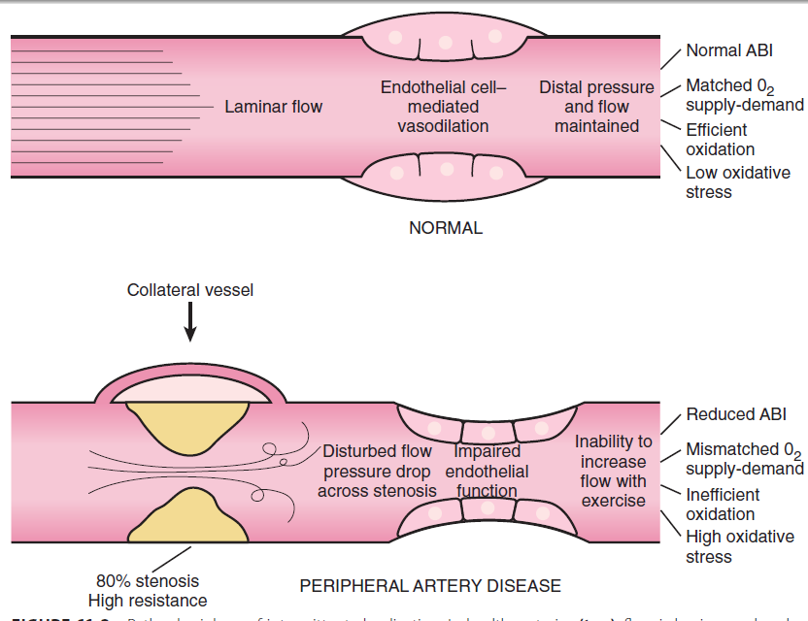
PATHOPHYSIOLOGY

Slide 18
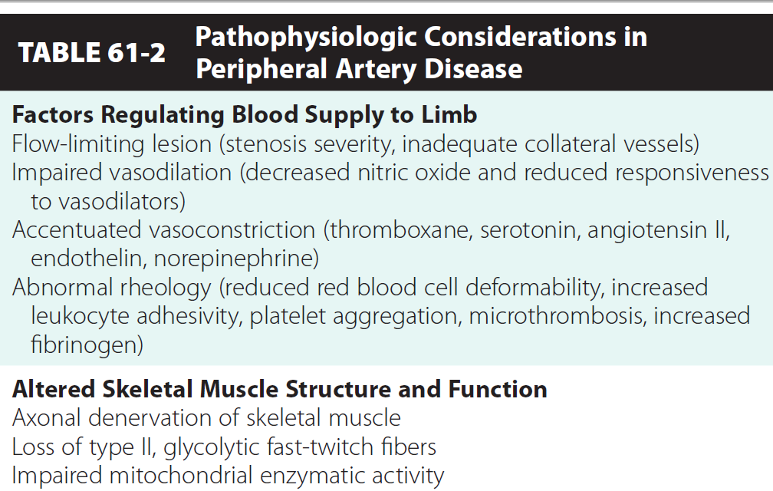
PATHOPHYSIOLOGY

Slide 19
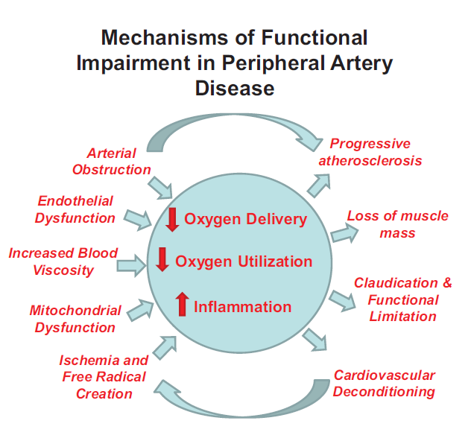

Slide 20
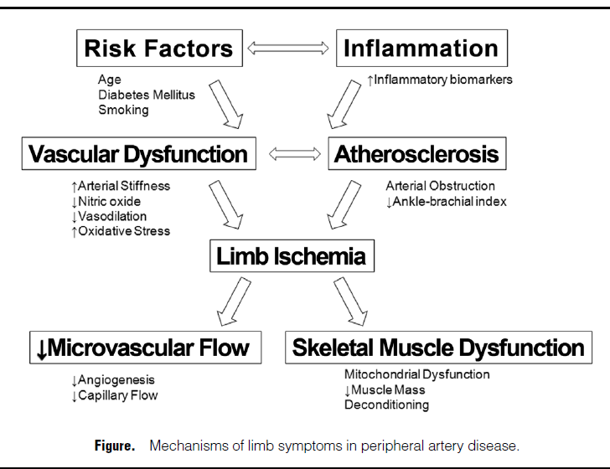

Slide 21
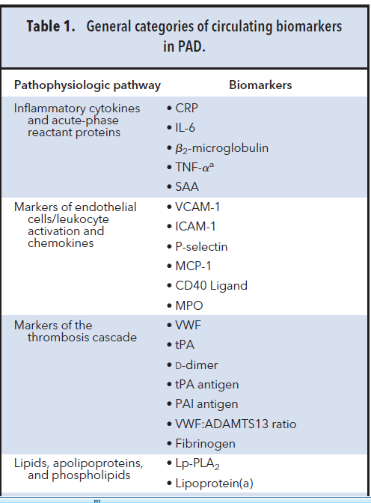
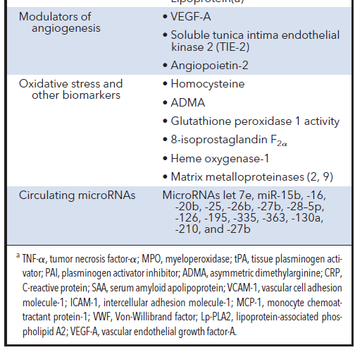
BIOMARKERS

Slide 22
Individuals at Risk for Lower-extremity Peripheral Arterial Disease
Age less than 50 years, with diabetes and one other atherosclerosis risk factor (smoking, dyslipidemia, hypertension, or hyperhomocysteinemia)
Age 50 to 69 years and history of smoking or diabetes
Age 70 years and older
Leg symptoms with exertion (suggestive of claudication) or ischemic rest pain
Abnormal lower extremity pulse examination
Known atherosclerotic coronary, carotid, or renal artery disease
ACC/AHA Guidelines

Slide 23
Natural History
Intermittent Claudication
Population > 55 yr
Intermittent
Claudication
5%
Peripheral Vascular
Outcomes
Other Cardiovascular
Morbidity/Total Mortality
Worsening
Claudication
16%
Lower Extremity
Bypass Surgery
7%
Major
Amputation
4%
Nonfatal
Cardiovascular
Event
(MI/Stroke)
20%
5-yr
Mortality
30%
Cardiovascular
Cause
75%

Slide 24
Clinical Presentation of PAD Patients
Chronic limb ischemia
Acute Limb Ischemia
Asymptomatic
PAD
Stable
Claudication

Slide 25
Intermittent Claudication
Definition: Recurring burning, aching, fatigue, or heaviness in the leg muscles with predictable level of walking, that resolves with a predictable duration of rest
It is not:
  pain at rest
  pain while standing, lying, or sitting
  pain that improves with walking

Slide 26
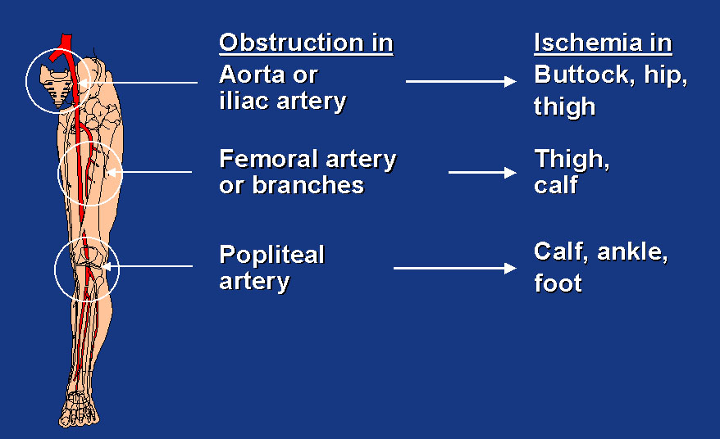
Common Sites of Claudication
25-30%
80-90%
40-50%
Tibial and peroneal arteries
Foot

Slide 27
Typical vs Atypical Symptoms
in Patients With Symptomatic PAD
Other nonspecific leg symptoms that may be indicative of PAD
Typical Symptoms
Intermittent claudication Exertional calf pain that causes the patient to stop walking resolves within 10 minutes of rest
Atypical Symptoms
Exertional leg pain that may involve areas other than the calves may not stop the patient from walking may not resolve within 10 minutes of rest
33%
>50%

Slide 28
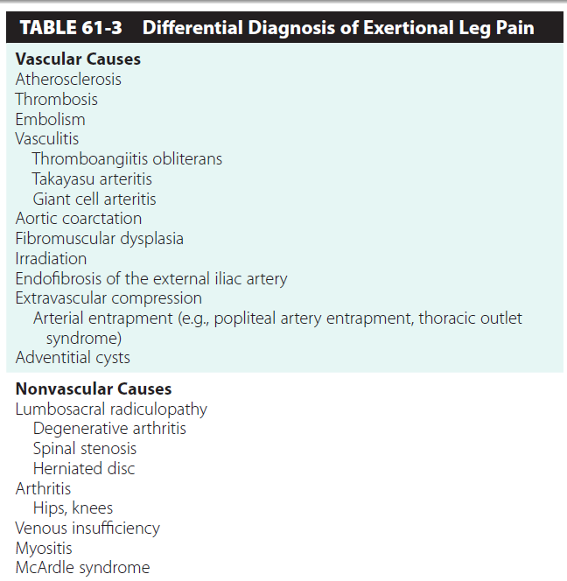

Slide 29
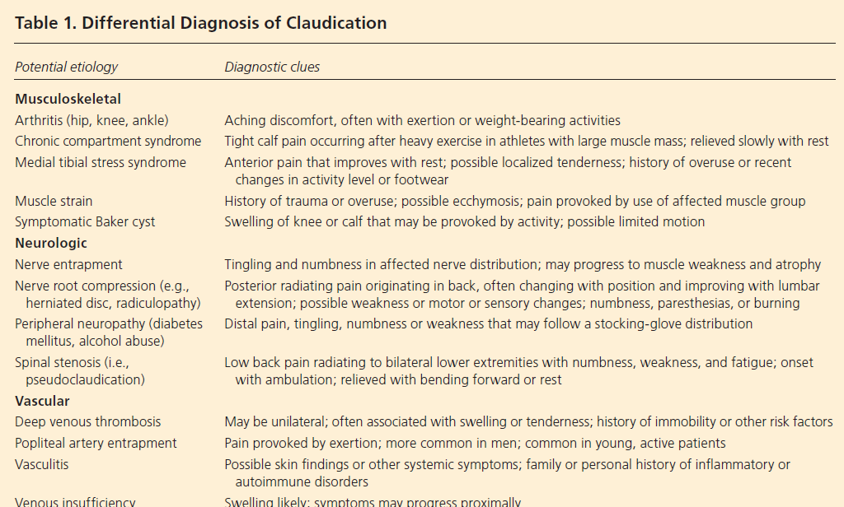

Slide 30
QUESTIONNAIRE FOR CLAUDICATION
Rose questionnaire
Edinbergh claudication questinnaire
San diego questionnaire
Walking impairment questionnaire
USEFUL IN EPIDEMIOLOGICAL STUDIES

Slide 31
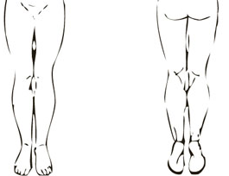
The Edinburgh Claudication Questionnaire
(6)Where do you get this pain or discomfort?
Mark the place (s) with an ‘X’ on the diagrams below
Front Back
Definition of positive classification requires all of the following responses: "Yes" to (1), "No" to (2), "Yes" to (3), grade 1 "No" to (4), grade 2 "Yes" to (4). If these criteria are fulfilled, a definite claudicant is one who indicates the pain is in the calf, regardless of whether pain is also marked at other sites; a diagnosis of atypical claudication is made if the pain is marked in the thigh or buttock, in the absence of any calf pain. Subjects should not be considered to have claudication if pain is indicated in the hamstrings, feet, shins, joints or appears to radiate in the absence of any pain in the calf
(1)Do you get a pain or discomfort in your leg(s) when you walk? Yes ⁭ No ⁭
If you answered "Yes" to question (1), please answer the following questions. Otherwise you need not continue
(2)Does this pain ever begin when you are standing still or sitting? Yes ⁭ No ⁭
(3)Do you get it if you walk uphill or hurry? Yes ⁭ No ⁭
(4)Do you get it if you walk at an ordinary pace on the level? Yes ⁭ No ⁭
(5)What happens to it if you stand still?
usually continues for more than 10 minutes usually disappears in 10 minutes or less

Slide 32
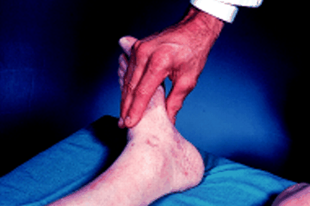
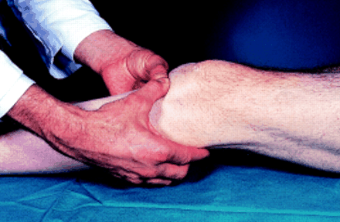
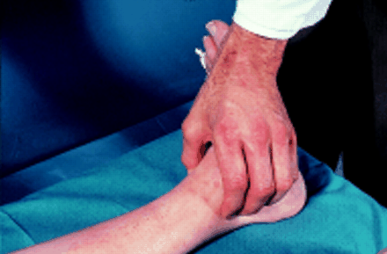
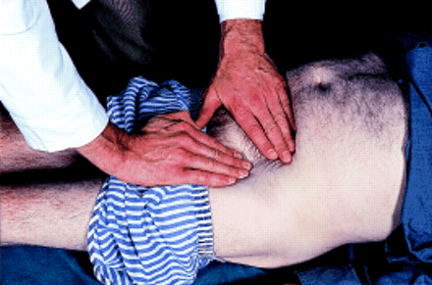
Physical Examination
Dorsalis Pedis
Popliteal Artery
Posterior Tibial
Femoral Pulse

Slide 33
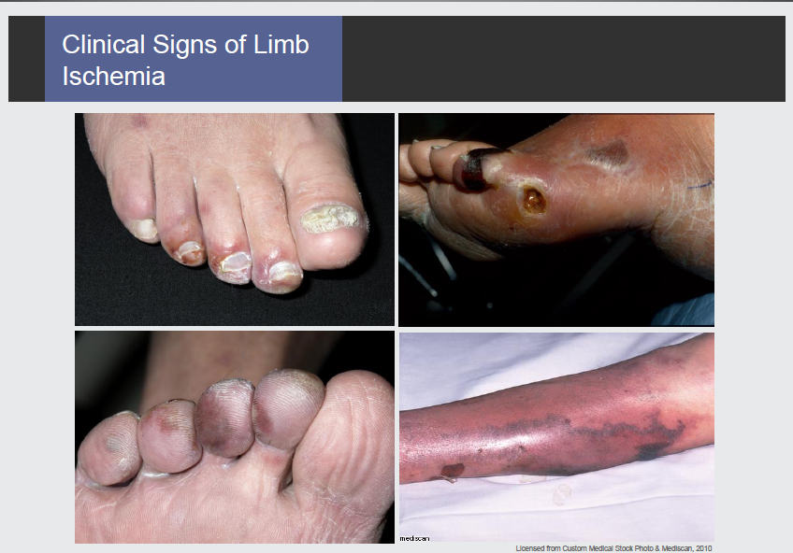

Slide 34
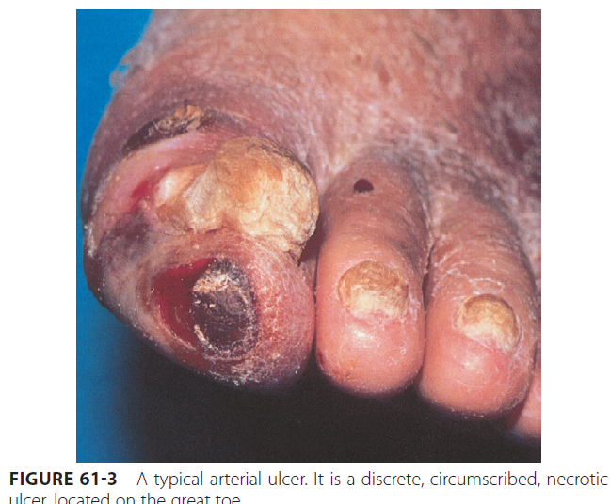
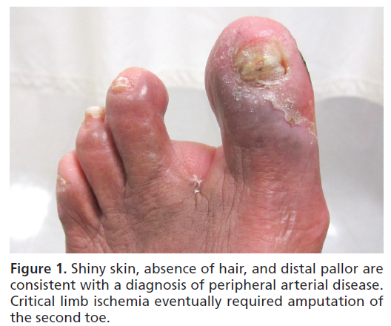

Slide 35
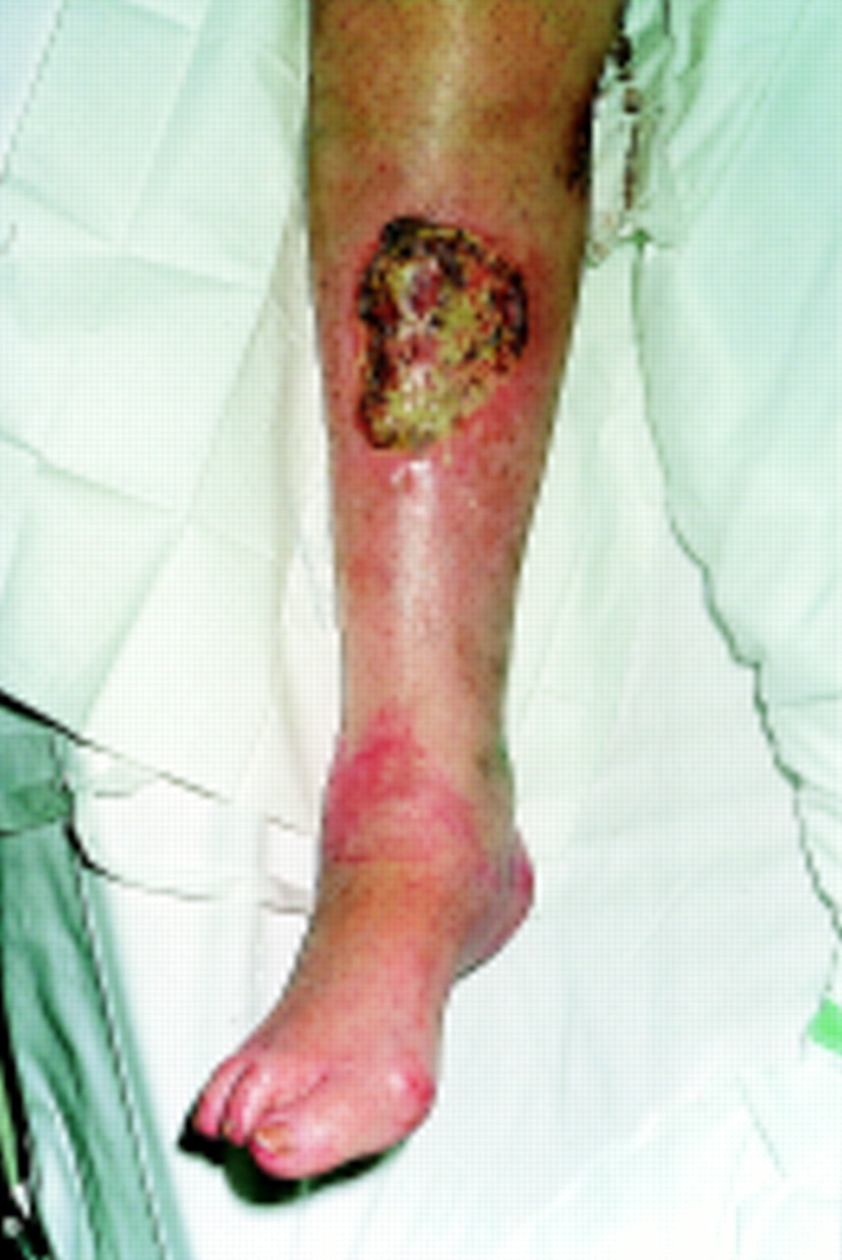
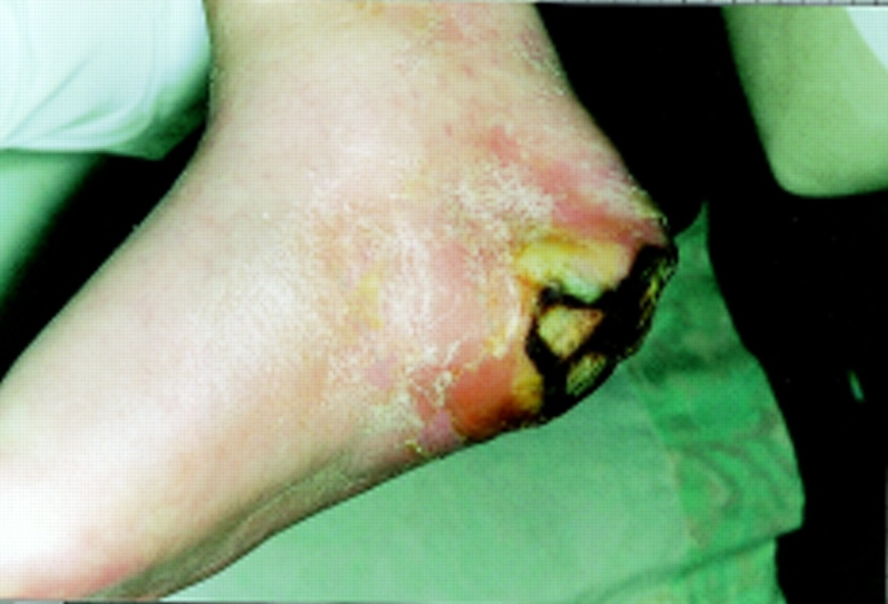
Arterial Ulcers Affecting Heel And Shin

Slide 36
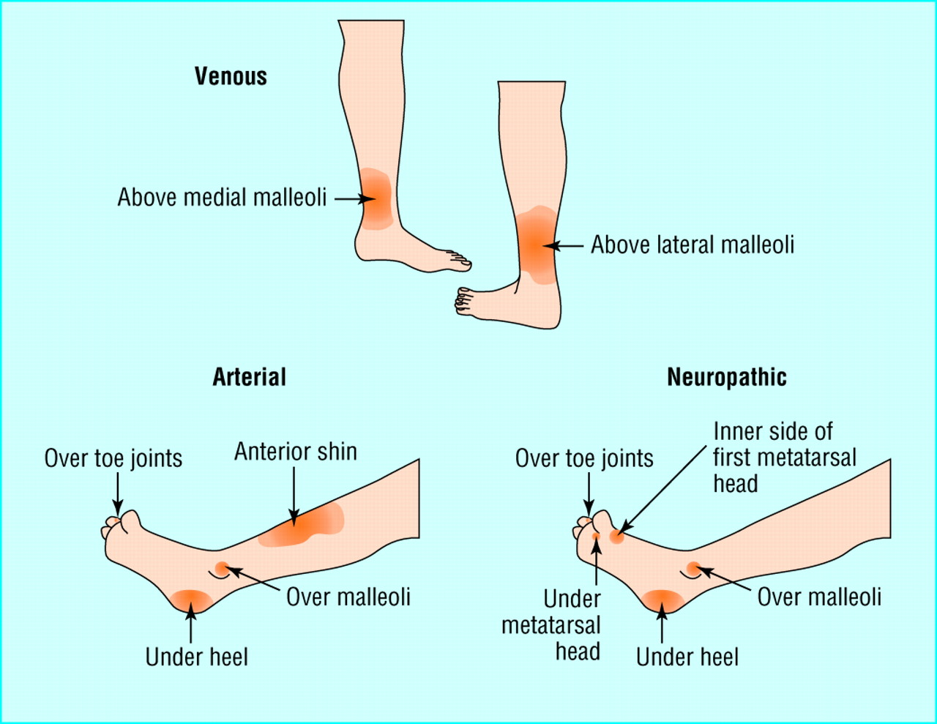
Common Sites Of Venous, Arterial And Neuropathic Ulceration

Slide 37
 | Arterial Ulcer | Venous Ulcer | Neuropathic Ulcer
Location | Toes or pressure points | Medial malleolus, Lateral/post. Calf | Sole of foot or bony prominences
Appearance | Irreg. margin, pale, cyanotic | Well-demarcated but irreg. margin, red base, exudative | “Punched out” appearance, red, often deep, infected
Foot Temp | Cool and dry | Warm | Warm and dry
Pain | Present, sometimes severe | Mild | Absent
Pulses | Absent | Present | +/-
Veins | Collapsed | Dilated, varicose, telangiectasias, reticular | Dilated
Sensation | Variable | Normal | Absent (no vibr sense)
Ulcer w/in callous | No | No | Often
Foot deformities | No | No | Often
Skin changes | Shiny, taut | Reddish-brown pigmentation, atrophie blanche | Shiny, taut, or doughy

Slide 38
Other associated signs/sx of PVD
Skin changes on LE
  Thin, brittle, and shiny
  Cool temperature
  Dusky erythema
  Hair loss
  Ulcers or non-healing wounds over pressure points
  Pallor when legs elevated
Diminished distal pulses
Toenail changes (thickened and opaque)
Impotence
Weakness / decreased mobility / muscle atrophy

Slide 39
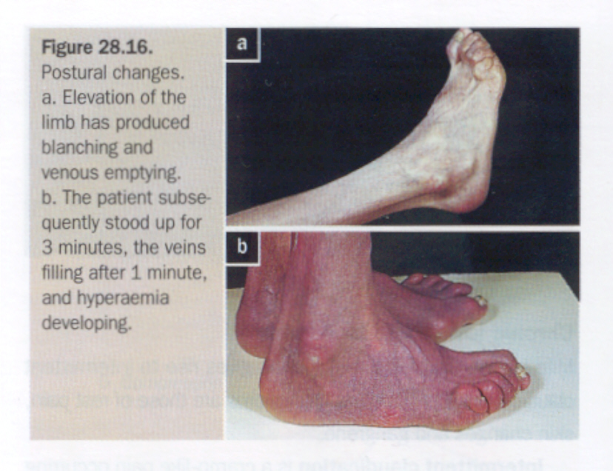
Buerger’s test
Patient is lying supine
Raise the foot and leg at 45 degrees or less
  Watch the leg becoming pale
Ask patient to sit up and hang the leg of the end of bed
  If leg becomes blue then red it’s a positive test (hyperactive hyperemia)

Slide 40
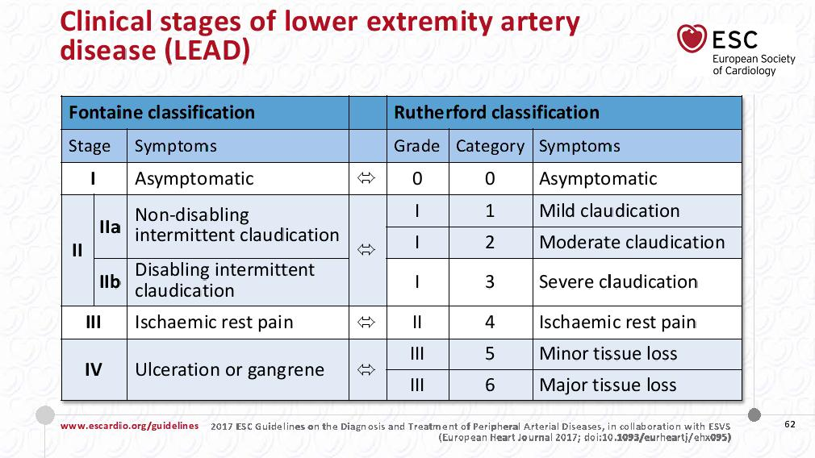

Slide 41
Diagnosis of PAD
Non-invasive techniques
  ABI
  Exercise Test
  Segmental Pressures
  Segmental Volume Plethysmography
  Duplex Ultrasonography
  CT A
  MRA
Invasive techniques
  Peripheral Angiograms

Slide 42
Clinical presentation | Noninvasive vascular test
Asymptomatic lower extremity PAD | ABI
Claudication | ABI, segmental pressures Duplex ultrasound Exercise test with ABI or assess functional status
Possible pseudoclaudication | Exercise test with ABI
Postoperative vein graft follow-up | Duplex ultrasound
Femoral pseudoaneurysm; iliac or popliteal aneurysm | Duplex ultrasound
Candidate for revascularization | Duplex ultrasound, MRA, or CTA

Slide 43
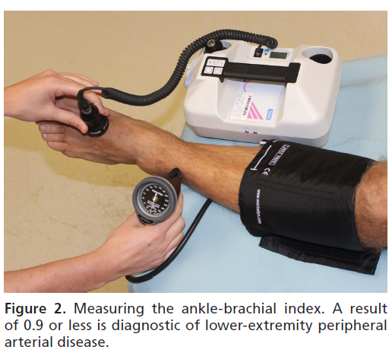
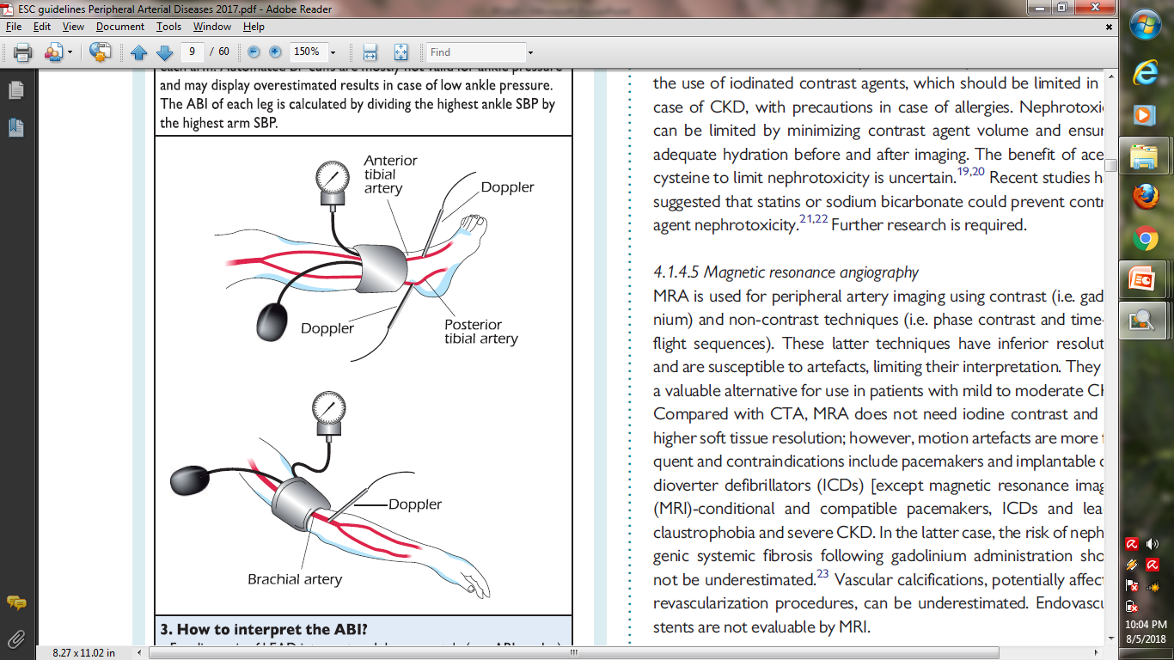
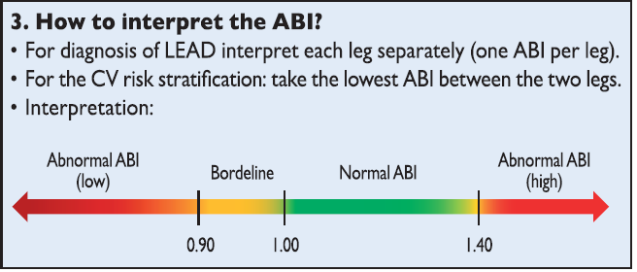

Slide 44
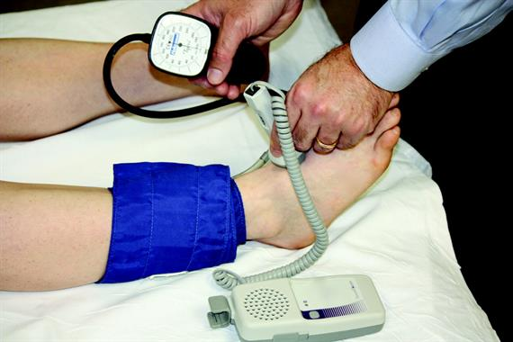
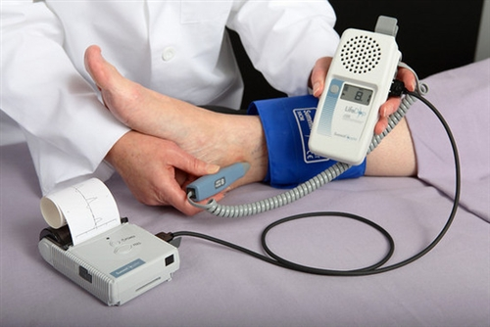
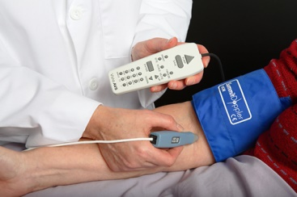

Slide 45
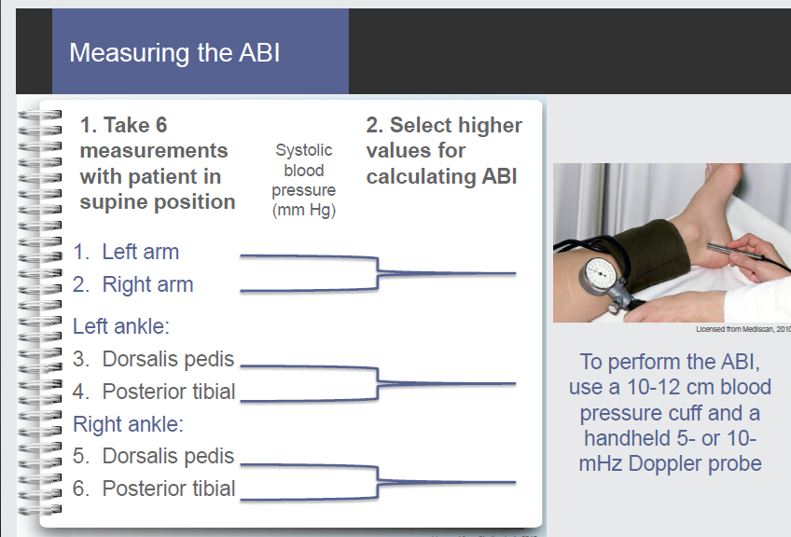

Slide 46
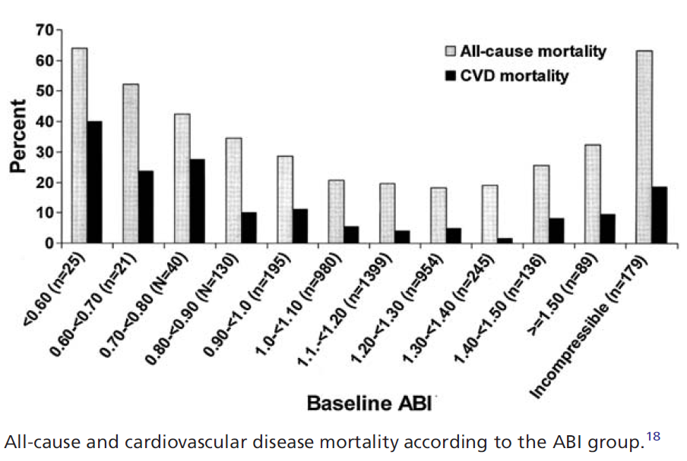

Slide 47
  Segmental Doppler pressures and
  Volume plethysmography
Segmental Doppler pressures:
  Used to determine level and severity of PVD
  Doppler cuff placed at proximal and distal thigh, calf, and ankle
  Assess for 20mmHg or more reduction in BP between arterial segments of same leg or compared to same level on contralateral leg
Plethysmography:
  Measures arterial volume changes in the limb segment below the cuff, using a standardized volume of air in cuff, and then measuring pulsatile pressures

Slide 48
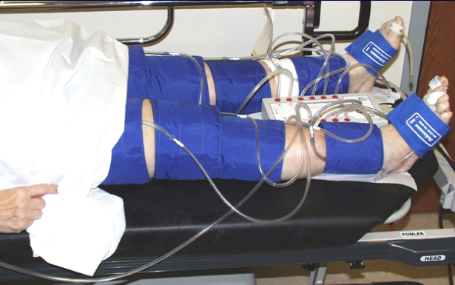
Segmental Pressures/ Pulse Volume Recordings

Slide 49
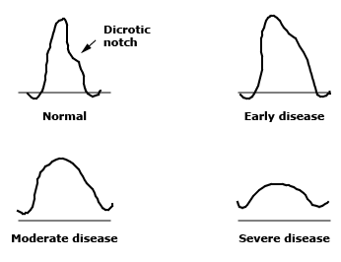
Segmental Doppler pressures and
Volume plethysmography
Mild --absence of a dicrotic notch
progressive obstruction-- the upstroke and downstroke become equal
severe disease--amplitude of the waveform is blunted.

Slide 50
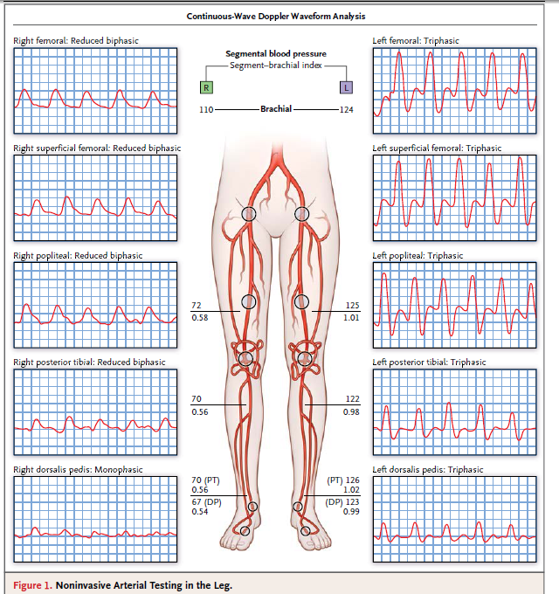

Slide 51
Post Exercise Ankle Pressures
>20% ABI
>30mmhg ankle SBP

Slide 52
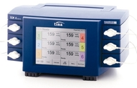
tcpO2
Testing peripheral skin perfusion on the capillary level
Closely corresponds to the capillary pressure of O2
To determine the degree of perfusion (ischemia)
evaluate the effectiveness of revascularization
determine amputation line
predict effect of hyperbaric oxygen therapy

Slide 53

tcpO2
tcpO2
> 50 mmHg | Normal
> 30 mmHg | Satisfactory
> 20 mmHg | Prediction of healing of amputation stump
< 10 mmHg | Critical ischemia

Slide 54
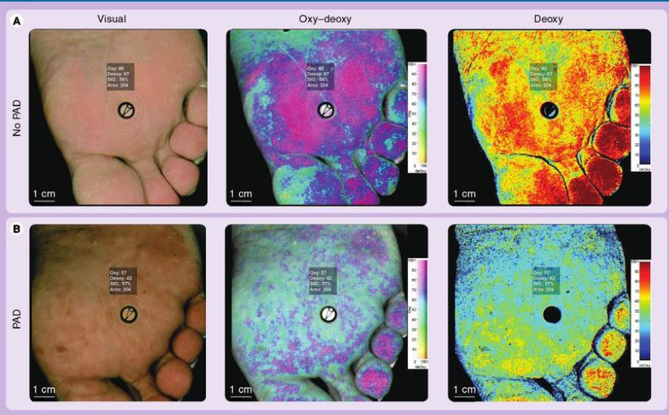
HYPER SPECTRAL IMAGING

Slide 55
Duplex Ultrasound
Benefits | Limitations
Can establish the lower extremity PAD diagnosis, establish localization, and define severity of local lower extremity arterial stenoses useful to select candidates for endovascular or surgical revascularization | Accuracy is diminished in proximal aortoiliac arterial segments in some individuals Dense arterial calcification can limit diagnostic accuracy Sensitivity is diminished for detection of stenoses downstream from a proximal stenosis Diminished predictive value in surveillance or prosthetic bypass grafts

Slide 56
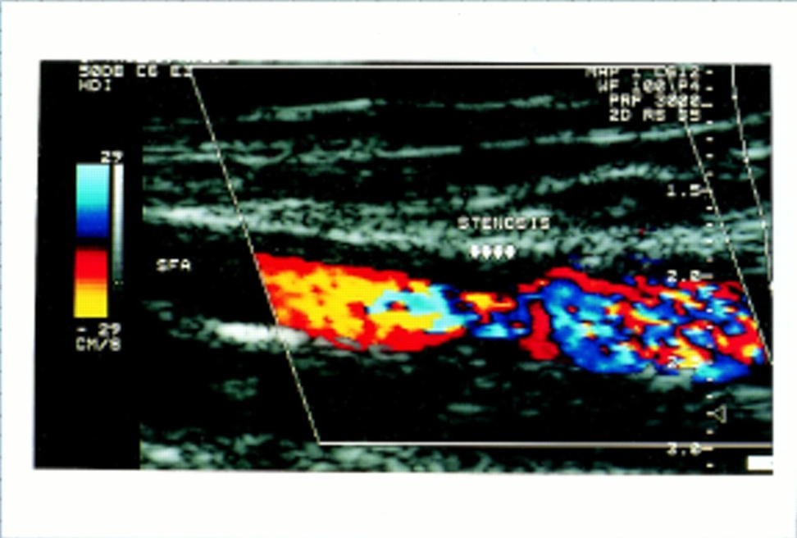
Non-invasive Diagnostic testing:
Duplex ultrasound
Can accurately localize and quantify lesions
Can differentiate between stenosis and occlusions, measure flow velocities in bypass grafts
Requires experienced technician

Slide 57
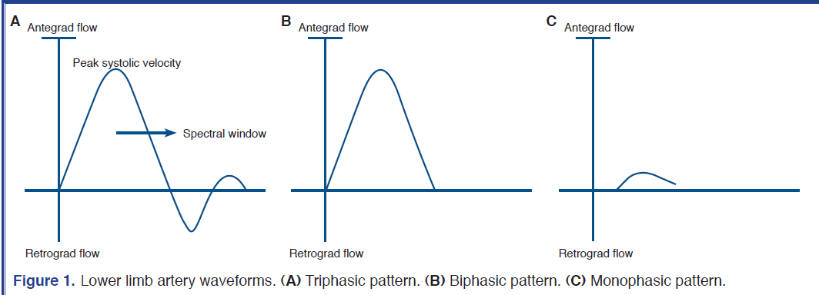
DUPLEX ULTRASOUND

Slide 58
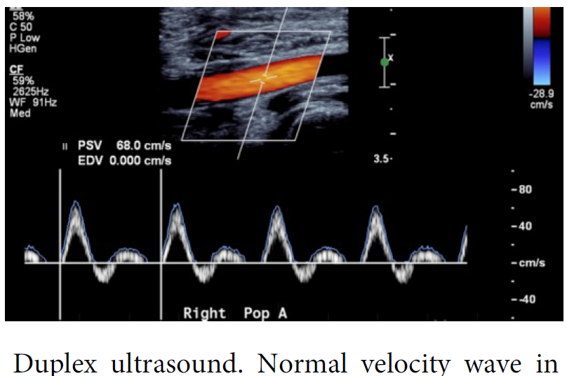

Slide 59
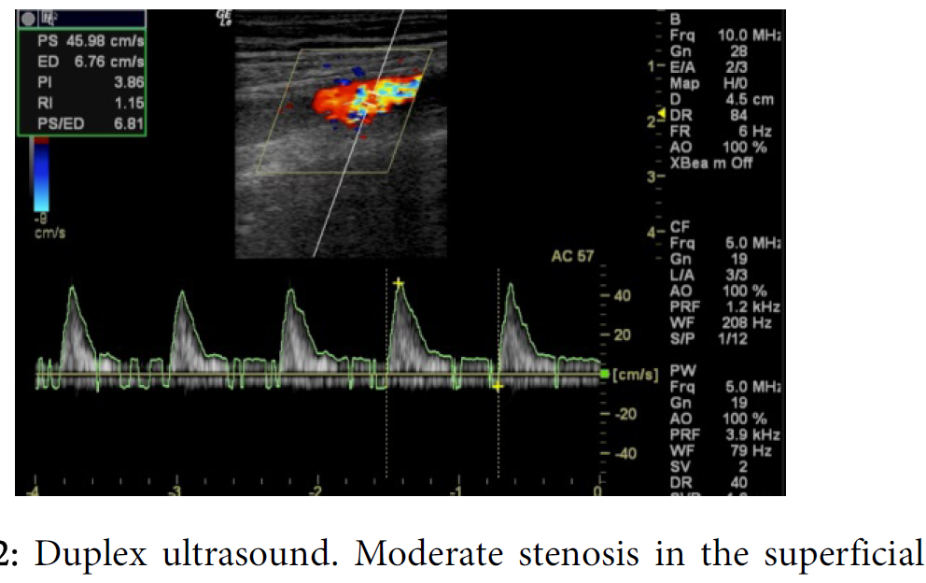

Slide 60
Computed Tomographic Angiography
Benefits | Limitations
Useful to asses PAD anatomy and presence of significant stenoses Useful to select patients who are candidates for endovascular or surgical revascularization Helpful to provide associated soft tissue diagnostic information that may be associated with PAD presentation Metal clips, stents, and metallic prostheses do not cause significant CTA artifacts Scan times are significantly faster than for MRA | Single-detector computed tomography lacks accuracy for detection of stenosis Spatial resolution lower than digital subtraction angiography Accuracy and effectiveness not as well determined as MRA Asymmetrical opacification in legs may obscure arterial phase in some vessels Requires iodinated contrast and ionizing radiation Venous opacification can obscure arterial filling

Slide 61
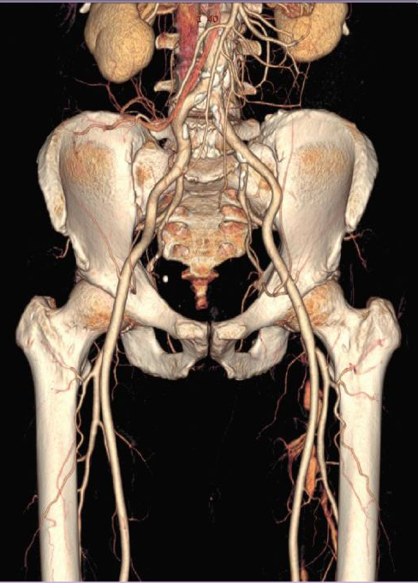
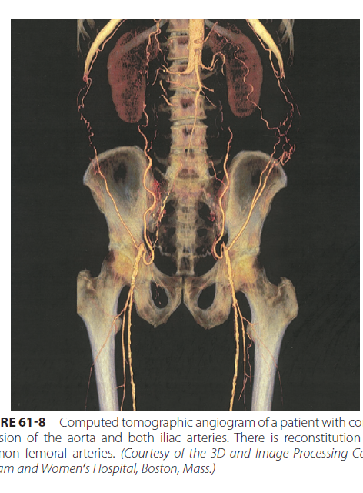

Slide 62
Magnetic Resonance Angiography
Benefits | Limitations
Useful to asses PAD anatomy and presence of significant stenoses Useful to select patients who are candidates for endovascular or surgical revascularization | Tends to overestimate the degree of stenosis May be inaccurate in arteries treated with metal stents Can not be used in patients with contraindications to the magnetic resonance technique

Slide 63



Slide 64


Advanced Vascular Imaging
MR Angiography
Traditional: Time of flights
Contrast-enhanced MRA
  Improves speed of exam, anatomic coverage, and small- vessel resolution
Time-resolved gadolinium enhanced sequences
  Time-resolved imaging of contrast kinetics (TRICKS)
  Provides angiographic like dynamic contrast passage
Moving-table technique or multi-array, parallel-imaging
  Optimize large field-of-view imaging
CT Angiography
Maximum-intensity projection (MIPs)
  Angiographic like representation
Volume rendering
  Preserves depth information
Multi-planar reformat
Curved planar reformat (CPR)
  Perpendicular to median arterial centerline

Slide 65


Slide 66


Slide 67


Slide 68

Invasive Diagnostic testing:
Contrast Angiography
Gold standard evaluation of lower extremity ischemia
Appropriate patient:
  No contraindication (allergy, AKI, risk of cholesterol emboli)
  Expected to undergo revasculartization
Study is from aorta down, bilaterally
CT or MR angiography can also be used

Slide 69
Diagnostic Testing for Suspected PAD

Slide 70


Slide 71


Slide 72
Peripheral Arterial Disease:
Goals of Therapy
Improvement in quality of life and functional
status
Identification and treatment of established
systemic atherosclerosis
    Prolong survival
Prevention of progression of atherosclerosis
    Aggressive risk factor intervention
Limb salvage

Slide 73
Cornerstones of Medical Therapies in PAD
Antiplatelet
Exercise
Statins
Smoking cessation
Cilostazol
Ace Inhibitors

Slide 74
Treatment of PAD
Prevent Ischemic Events
Risk factor modification
Smoking cessation
  Goal: complete cessation
Lipid management
  Target LDL < 100 mg/dL
Blood pressure control
  Goal <130/85 mm Hg
Blood sugar control
  Goal: HbA_{1c} <7%
Antiplatelet therapies
Aspirin or Clopidogrel
  Goal: reduction in risk of MI, stroke, and vascular death
  Only clopidogrel is FDA approved

Slide 75
Effect of Smoking Cessation
on Survival in PAD
131 Patients Followed After Bypass Graft or Lumbar Sympathectomy Surgery
Faulkner et al. Med J Aust 1983;1:217.

Slide 76
Impact of Smoking Cessation on PAD
Jonason & Bergström. Acta Med Scand 1987;221:253-60

Slide 77


Slide 78
Mechanisms of Action of Exercise Therapy in Peripheral Arterial Disease
Enlarging the radius of the supply vessel
Enhance collateral growth
Increase pressure gradient across stenosis
Increase oxidative capacity of muscle cells
Increase in Type I muscle fibers
Higher ‘fluidity’ of arterial blood flow
Enhanced oxygen affinity of hemoglobin
Improved endothelial function

Slide 79


Slide 80


Slide 81
Treatment of PAD
Effect of Exercise Training
Meta-analysis of 21 Studies
200
180
Exercise Training
160
Control
140
120
Change in Treadmill
Walking Distance (%)
179%
100
122%
80
60
40
20
0
Onset of
Claudication Pain
Maximal
Claudication Pain
Gardner AW. JAMA. 1995;274:975-980.
Notes:
The bar graphs show the results of a meta-analysis of 21 studies that assessed the benefits of exercise training in patients with IC.
In subjects who followed a program of exercise training, the mean distance to onset of claudication pain increased 179%, and the distance to maximal claudication pain increased 122% compared with the distances for controls.
These differences were significant at a level of P < 0.001.
The greatest improvements were found in exercise programs whose sessions lasted longer than 30 minutes, that incorporated at least 3 sessions per week, that used near-maximal pain during training as the pain end point, and that lasted longer than 6 months.
Keywords: meta-analysis, IC
Gardner AW, Poehlman ET. Exercise rehabilitation programs for the treatment of claudication pain.
A meta-analysis. JAMA. 1995;274:975-980.

Slide 82


Slide 83
Cholesterol Reduction and the
Development of Intermittent Claudication
]
Placebo
38%
Simvastatin
Scandinavian Simvastatin Survival Study Pedersen et al. Am J Card 1998;81:333-5.

Slide 84
Heart Protection Study: Simvastatin
Vascular Event by Prior Disease
Incidence of Events
Statin
Control
Risk versus Control
Existing Disease
(n=10,269)
(n=10,267)
Statin Favored
Placebo
Previous MI
23.5
29.4
Other CHD
18.9
24.2
No prior CHD or CVD
18.7
23.6
Peripheral arterial disease
24.7
30.5
24% Reduction (p<0.0001)
Diabetes
13.8
18.6
All patients
19.8
25.2
0.4
0.6
0.8
1.0
1.2
1.4
Notes:
The Heart Protection Study compared the effects of taking 40 mg simvastatin or matching placebo daily for 5 years on mortality and vascular event rates in 20,536 adults age 40 to 80 years in the United Kingdom who had coronary disease, other occlusive arterial disease, or diabetes.

Slide 85


Slide 86

CAPRIE Study
Efficacy of Clopidogrel in Primary Analysis of MI, Ischemic Stroke, or Vascular Death
ITT Analysis
CAPRIE Steering Committee Lancet 1996; 348: 1329-1339

Slide 87
CAPRIE Study
Outcome by Subgroup
CAPRIE Steering Committee Lancet 1996; 348: 1329-1339

Slide 88


Slide 89

Efficacy of ACE-I, Stantins and Antiplatelet therapy in PAD
*PAD Subgroup only
APTC Antiplatelet Trialists’ Collaboration BMJ 1994; 308:81-106
CAPRIE Steering Committee Lancet 1996; 348: 1329-1339
HOPE Study Investigators N Engl J Med 2000; 342:145-153
HPS Collaborative group Lancet; 2002; 360:7-22

Slide 90
Pharmacologic Effects of Cilostazol

Slide 91
Treatment of PAD
Effect of Drug Therapy on Walking Distance
Meta-analysis of 4 randomized, placebo-controlled trials
Compound, dose
N
Placebo
Treatment Favored
Pentoxifylline, 1200 mg/day
Cilostazol, 200 mg/day
698
Cilostazol, 200 mg/day
Cilostazol, 100 mg/day
516
Cilostazol, 200 mg/day
239
Cilostazol, 200 mg/day
81
0.6
0.8
1.0
1.2
1.4
1.6
1.8
Relative Increase in Maximum Walking Distance
(ratio of change in exercise performance versus placebo)
Hiatt WR. N Engl J Med. 2001; 344;1608-1621.
Notes:
In four randomized, placebo-controlled trials that enrolled 1534 patients with IC, cilostazol, 100 mg twice daily, consistently improved maximal walking distance when compared with placebo.
In one trial of these trials, cilostazol, 100 mg twice daily, was superior to both placebo and pentoxifylline, 1,200 g daily, in its ability to increase maximal walking distance
In this trial, pentoxifylline had no effect on maximal walking distance
In one trial, cilostazol, 50 mg twice daily, also increased maximal walking distance
In three of the trials, cilostazol also improved several aspects of physical functioning and QOL as assessed by patient questionnaire scores
Cilostazol also increases ABI slightly and elevates HDL-C level.
Keywords: IC, cilostazol, walking distance, pentoxifylline, ABI
Hiatt WR. Medical treatment of peripheral arterial disease and claudication. N Engl J Med. 2001;344:1608-1621.

Slide 92
Effect of Cilostazol vs. Pentoxifylline on Walking Distance in Patients with Claudication
Cilostazol 100 mg bid po
Pentoxifylline 400 mg tid
Placebo
*
*
P <0.05 at all time points
Dawson, et al. Am. J. Med., 2000.

Slide 93

Aspirin for asymptomatic atherosclerosis
Prevention of progression of arterial ds and diabetes
Clopidogrelvs aspirin in pt at risk of ischemic events
Examining use of ticagrelor in PAD

Slide 94


Slide 96


Slide 98

Warfarin antiplatelet vascular evaluation

Slide 99

Dutch bypass oral anticoagulant trial

Slide 100
Antiplatelet Agents
COR | LOE | Recommendations
I | A | Antiplatelet therapy with aspirin alone (range 75–325 mg per day) or clopidogrel alone (75 mg per day) is recommended to reduce MI, stroke, and vascular death in patients with symptomatic PAD.
IIa | C-EO | In asymptomatic patients with PAD (ABI ≤0.90), antiplatelet therapy is reasonable to reduce the risk of MI, stroke, or vascular death.
IIb | B-R | In asymptomatic patients with borderline ABI (0.91–0.99), the usefulness of antiplatelet therapy to reduce the risk of MI, stroke, or vascular death is uncertain.
IIb | B-R | The effectiveness of dual-antiplatelet therapy (aspirin and clopidogrel) to reduce the risk of cardiovascular ischemic events in patients with symptomatic PAD is not well established.
IIb | C-LD | Dual-antiplatelet therapy (aspirin and clopidogrel) may be reasonable to reduce the risk of limb-related events in patients with symptomatic PAD after lower extremity revascularization.
IIb | B-R | The overall clinical benefit of vorapaxar added to existing antiplatelet therapy in patients with symptomatic PAD is uncertain.

Slide 101
Oral Anticoagulation
COR | LOE | Recommendations
IIb | B-R | The usefulness of anticoagulation to improve patency after lower extremity autogenous vein or prosthetic bypass is uncertain.
III: Harm | A | Anticoagulation should not be used to reduce the risk of cardiovascular ischemic events in patients with PAD.
Cilostazol, Pentoxifylline, and Chelation Therapy
COR | LOE | Recommendations
Cilostazol
I | A | Cilostazol is an effective therapy to improve symptoms and increase walking distance in patients with claudication.
Pentoxifylline
III: No Benefit | B-R | Pentoxifylline is not effective for treatment of claudication.
Chelation Therapy
III: No Benefit | B-R | Chelation therapy (e.g., ethylenediaminetetraacetic acid) is not beneficial for treatment of claudication.
COR | LOE | Recommendation
I | C-EO | Patients with PAD should have an annual influenza vaccination.

Slide 102


Slide 103


Slide 104
Treatment of Symptomatic Lower Extremity Atherosclerotic Occlusive Disease:
Nonoperative | Endovascular | Surgery
Risk factor modification Exercise Drugs (including thrombolytic agents | Transluminal angioplasty Endovascular stents Intra-arterial thrombolytic therapy | Endarterectomy Bypass grafting Autogenous prosthetic Amputation

Slide 105
The Team

Slide 106


Slide 107


Slide 108



Balloon Angioplasty

Slide 109


Slide 110


Slide 111


Slide 112

EXCIMER LASER(SPECTRONETICS CORP)

Slide 113

ORBITAL ATHERECTOMY(TURBOHAWK CATHETER)

Slide 114

DIRECTIONAL ATHERECTOMY(JET STREAM CATHETER)

Slide 115


Slide 116
Revascularization for
Aorto-Iliac Arterial Disease
Aortofemoral Bypass
Primary patency at 5 years of 81-85%
Perioperative mortality 5-8%
Reserved for severe diffuse disease cases
Indicated for Rutherford class ≥ 3
Percutaneous Intervention
Patency at 5 years of 65-80%
Perioperative mortality 0.1%
Treatment of choice
Indicated for Rutherford class ≥ 2

Slide 117


Slide 118
Lesion-guided approach for treatment of aorto-iliac disease
A
Endovascular is procedure of choice
C
Surgery is preferred for good-risk
D
Surgery is procedure of choice
B
Endovascular is preferred therapy
TASC II 2007

Slide 119
Treatment of PAD
Revascularization for Femoro-Popliteal Disease
Femoro-Popliteal Bypass Surgery
  Primary patency at 5 years of 60-80%
  Autologous veins preferred to synthetic grafts
  Perioperative mortality 0-3%
  Indicated for Rutherford class ≥ 3
Femoro-Popliteal Angioplasty
  Patency at 2-5 years ranges between 40-70%
  Technical problems due several anatomic issues:
    Occlusions vs stenosis
    Diffuse disease
    Adductor canal
    Disease in run off vessels
  Perioperative mortality is very low
  Indicated for Rutherford class ≥ 2

Slide 120




Slide 121
Lesion-guided approach for treatment of femoro-popliteal disease
A
Endovascular is procedure of choice
B
Endovascular is preferred therapy
C
Surgery is preferred for good-risk
D
Surgery is procedure of choice
TASC II 2007

Slide 122


Slide 123


Slide 124
Endovascular Revascularization for Claudication
COR | LOE | Recommendations
I | A | Endovascular procedures are effective as a revascularization option for patients with lifestyle-limiting claudication and hemodynamically significant aortoiliac occlusive disease.
IIa | B-R | Endovascular procedures are reasonable as a revascularization option for patients with lifestyle-limiting claudication and hemodynamically significant femoropopliteal disease.
IIb | C-LD | The usefulness of endovascular procedures as a revascularization option for patients with claudication due to isolated infrapopliteal artery disease is unknown.
III: Harm | B-NR | Endovascular procedures should not be performed in patients with PAD solely to prevent progression to CLI.

Slide 125
Surgical Revascularization for Claudication
COR | LOE | Recommendations
I | A | When surgical revascularization is performed, bypass to the popliteal artery with autogenous vein is recommended in preference to prosthetic graft material.
IIa | B-NR | Surgical procedures are reasonable as a revascularization option for patients with lifestyle-limiting claudication with inadequate response to GDMT, acceptable perioperative risk, and technical factors suggesting advantages over endovascular procedures.
III: Harm | B-R | Femoral-tibial artery bypasses with prosthetic graft material should not be used for the treatment of claudication.
III: Harm | B-NR | Surgical procedures should not be performed in patients with PAD solely to prevent progression to CLI.

Slide 126

Bypass grafts

Slide 127



Slide 128


Slide 129


Slide 130


Slide 131


Slide 132


Slide 133
CLI
CLI Definition:
A condition characterized by chronic (≥2 wk) ischemic rest pain, nonhealing wound/ulcers, or gangrene in 1 or both legs attributable to objectively proven arterial occlusive disease.
The diagnosis of CLI is a constellation of both symptoms and signs.
Arterial disease can be proved objectively with ABI, TBI, TcPO₂, or skin perfusion pressure.
Supplementary parameters, such as absolute ankle and toe pressures and pulse volume recordings, may also be used to assess for significant arterial occlusive disease

Slide 134
Diagnostic Testing for Suspected CLI

Slide 135


Slide 136


Slide 137
Prognosis of Critical Limb Ischemia
PRIMARY TREATMENT
ONE YEAR LATER
Medical Treatment
Only
Alive Amputated
Continuing CLI
25%
20%
25%
50%
25%
25%
30%
Primary Amputation
Revascularization
Dead
CLI Resolved

Slide 138
Acute Limb Ischemia
ALI Definition:
Acute (<2 wk), severe hypoperfusion of the limb characterized by these features: pain, pallor, pulselessness, poikilothermia (cold), paresthesias, and paralysis.

Slide 139
Acute Limb Ischemia
ETIOLOGY: a)embolization
b)direct trauma
c)thrombosis
MANAGEMENT
Heparin
Surgical therapy – embolectomy or urgent bypass
Thrombolytic therapy (urokinase, reteplase, alteplase)
COMPLICATIONS: 1.Reperfusion injury
2.Myonephropathic syndrome
3.Compartment syndrome

Slide 140


Slide 141


Slide 142


Slide 143


Slide 144


Slide 145


Slide 146
Diagnosis and Management of ALI

Slide 147


Slide 148


Slide 149
Revascularization for ALI
COR | LOE | Recommendations
I | C-LD | In patients with ALI, the revascularization strategy should be determined by local resources and patient factors (e.g., etiology and degree of ischemia).
I | A | Catheter-based thrombolysis is effective for patients with ALI and a salvageable limb.
I | C-LD | Amputation should be performed as the first procedure in patients with a nonsalvageable limb.
I | C-LD | Patients with ALI should be monitored and treated (e.g., fasciotomy) for compartment syndrome after revascularization.
COR | LOE | Recommendations
IIa | B-NR | In patients with ALI with a salvageable limb, percutaneous mechanical thrombectomy can be useful as adjunctive therapy to thrombolysis.
IIa | C-LD | In patients with ALI due to embolism and with a salvageable limb, surgical thromboembolectomy can be effective.
IIb | C-LD | The usefulness of ultrasound-accelerated catheter-based thrombolysis for patients with ALI with a salvageable limb is unknown.

Slide 150


Slide 151


Slide 152


Slide 153
Thank you

